Slide 1

WebDriver environment & Framework setup
wantsome.ro
Mai mult
decât știai.
27/02/2021

Slide 2

WebDriver environment & Framework setup/ Agenda
Project setup using maven
Split everything into maven modules
Leverage built-in PageFactory model
Make your automated tests implementation reflect manual tests
Running tests on different browsers/platforms has never been much easier
//
1
wantsome.ro

Slide 3

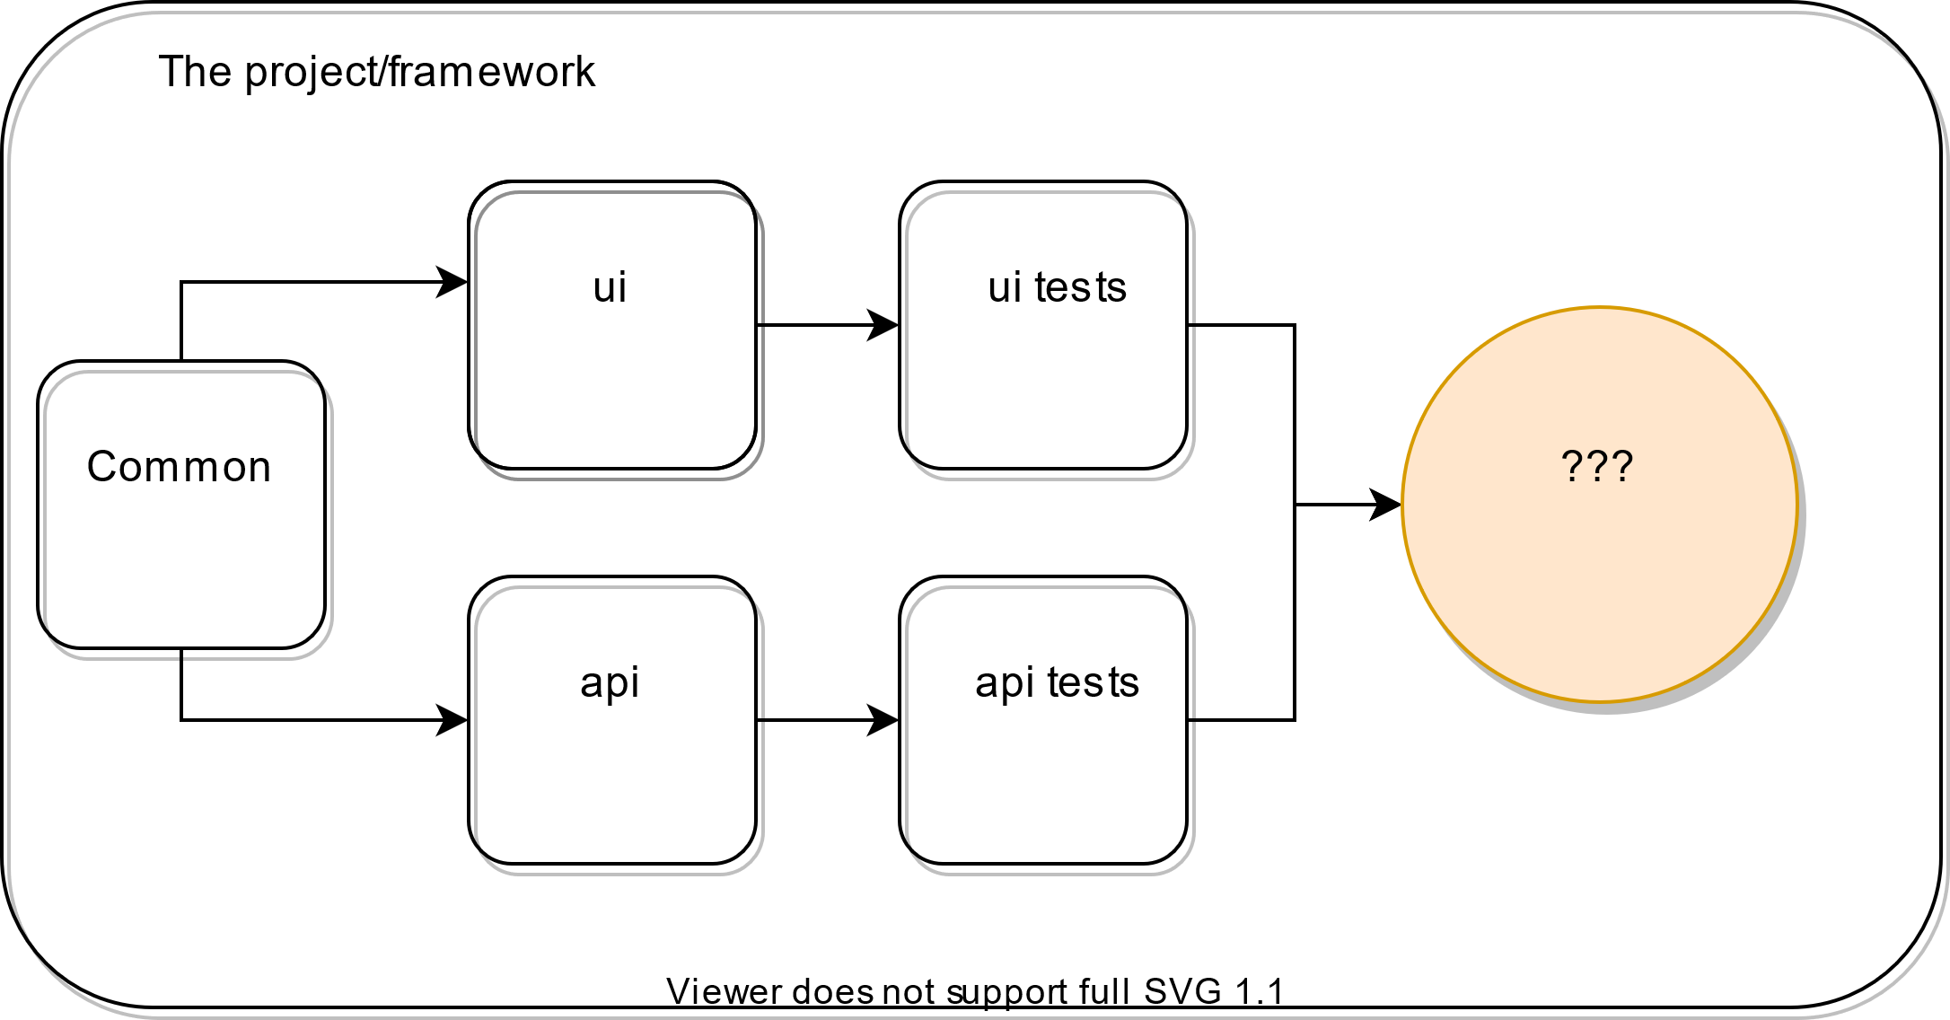
WebDriver environment & Framework setup/ Project architecture
2
wantsome.ro

Slide 4
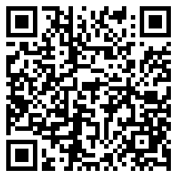
WebDriver environment & Framework setup/ Implementation
Let`s see how the implementation looks like !
https://github.com/BogdanLivadariu/wantsome-playground/tree/master/automation-framework
3
wantsome.ro

